Slide 1
B. Tech ECE FINAL YEAR PROJECT - THIRD REVIEW Signboard Translation from Vernacular Languages
17BEC0003 – Karveandhan P
17BEC0055 – Sachin K
17BEC0129 - K Shivaani
Faculty GUIDE: Prof. Sankar Ganesh S

Slide 2
Current status and Motivation
India has 22 constitutionally recognized languages written in 13 different scripts. An average traveler, on a business or pleasure trip, often gets confused by the various signboards written in an unfamiliar language in a new region. This often spoils the experience of visiting a new place and the traveler goes back with not-so-fond memories. This often leads to language tussles wherein people of region A may feel that people of region B are not considerate enough to display signboards in their language and vice versa.
To begin with, we are working on Hindi and English as the primary languages. This is also because of lack of data sets for other regional languages.

Slide 3
Software Details
Platform for Execution : Google Colab
Source for Datasets : Ai4bharat
Performing Image Processing Techniques : Roboflow
Algorithms Involved in the Project : Yolov4 Tiny, East, PyTesseract, EasyOCR, Encoder Decoder Model.
Programming Language : Python

Slide 4
Objective
The goal of this project is to transliterate the text written on a signboard to another language as desired by the user (Typically 1 language transliteration due to the complexity involved)

Slide 5
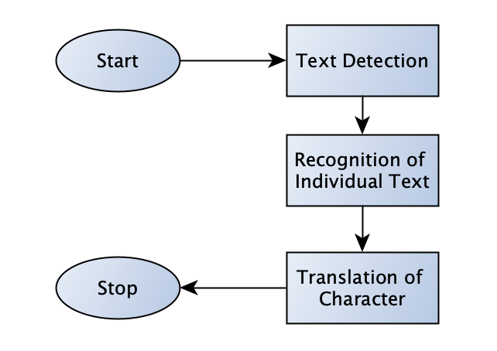
BLOCK Diagram

Slide 6
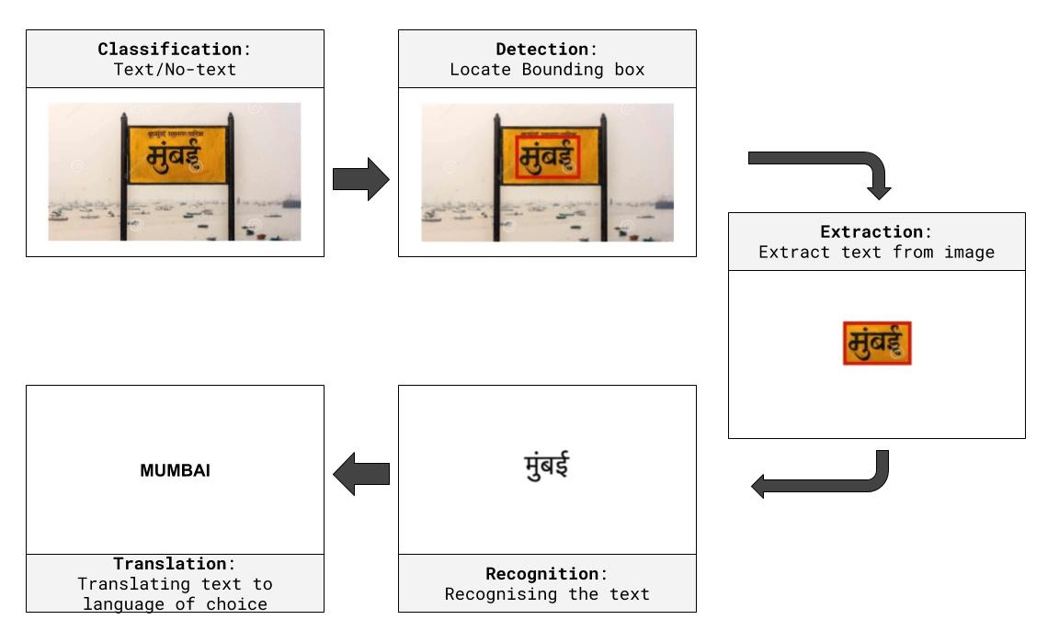
The Process

Slide 7
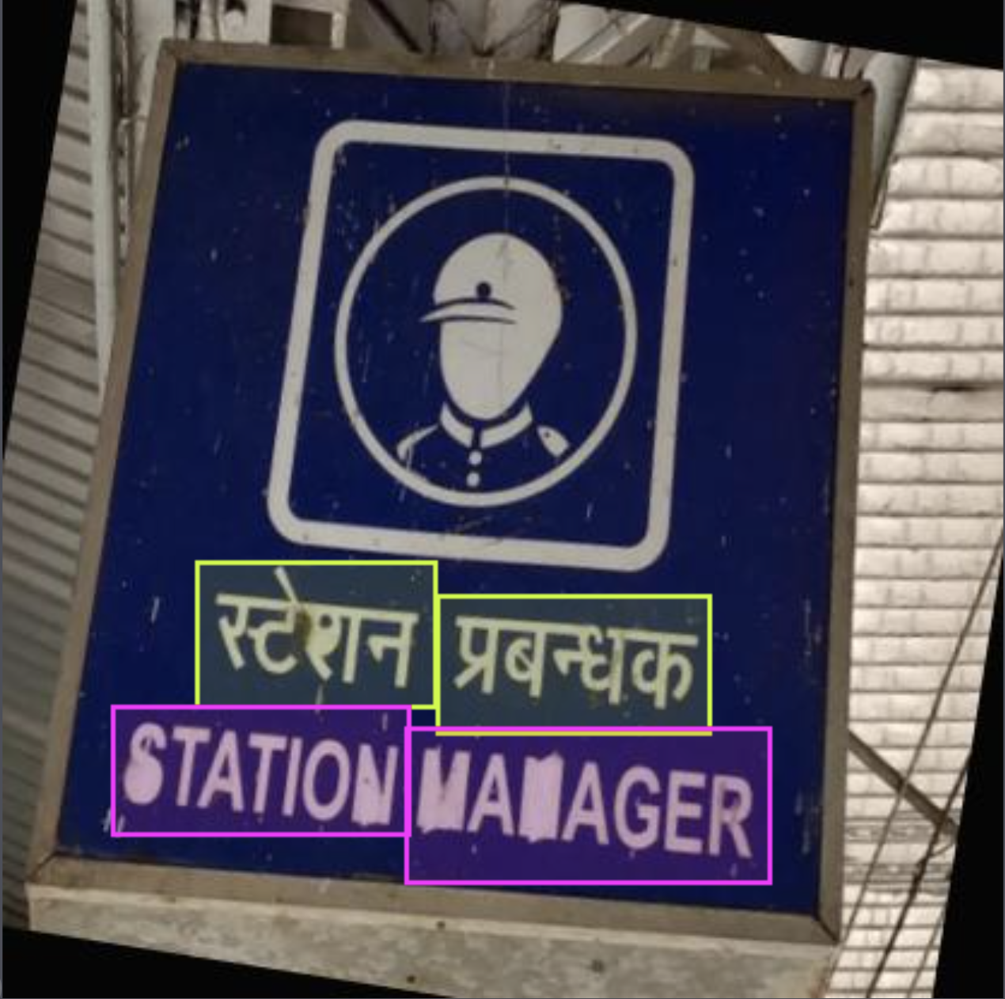
Methodology Phase 1 (Detection of text from the image)
Text Recognition - Just like detecting real life objects, we detect text here with classification as Languages. The images involving text are annotated by drawing boundary boxes and labelling them to their respective classes (Languages).
There are numerous languages with which classification can be performed. Here, in this project we predominantly work on Hindi and English. So, we classify the images given into these two categories.
The Algorithms used in this process are:
YOLO v4
EAST

Slide 8
Methodology Phase 2 (Recognising String)
After detecting the region of text from the image, the text has to be extracted separately. In order to extract the text from the image, we used OCR tools such as
PyTesseract
EasyOCR
PyTesseract is used for detecting the English text from the images.
EasyOCR is used for detecting Multiple Language (English and Hindi for our Purpose) from the Image.

Slide 9
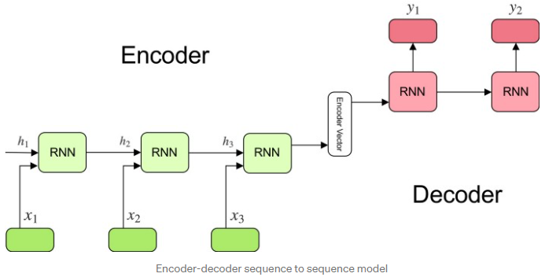
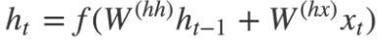
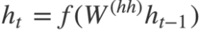
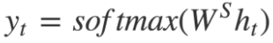
Methodology-Phase 3 (Transliteration) Using Sequence to Sequence model

Slide 10
Methodology-Phase 3 (Transliteration) Seq2Seq model with Attention mechanism
Encoder: It consists of a stack of several recurrent units (LSTM or GRU cells for better performance) where each accepts a single element of the input sequence, collects information for that element and propagates it forward.
Attention layer: It consists of attention weights and context vector.
Attention weights: We apply a softmax activation function to obtain the attention weights. This will help to represent the weight of influence for each of the input sequence. Higher the attention weight of the input sequence, the higher will be its influence on predicting the target word.
Context vector: The context vector is used to compute the final output of the decoder. The context vector 𝒸ᵢ is the weighted sum of attention weights and the encoder hidden states (h₁, h₂, …,hₜₓ), which maps to the input sentence.
Decoder: It consists of a stack of several recurrent units where each predicts an output y_t at a time step t. Each recurrent unit accepts a hidden state from the previous unit and produces an output as well as its own hidden state.

Slide 11
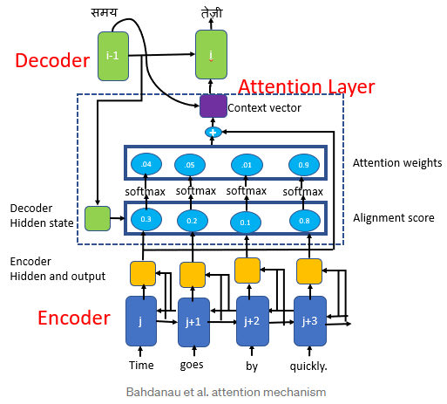
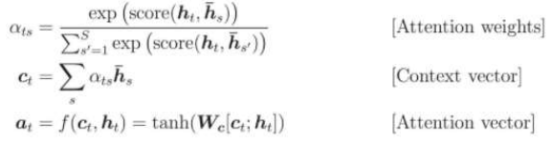
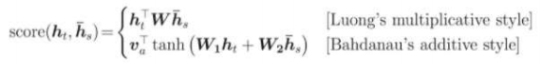
Methodology-Phase 3 (Transliteration) Seq2Seq model with Attention mechanism

Slide 12
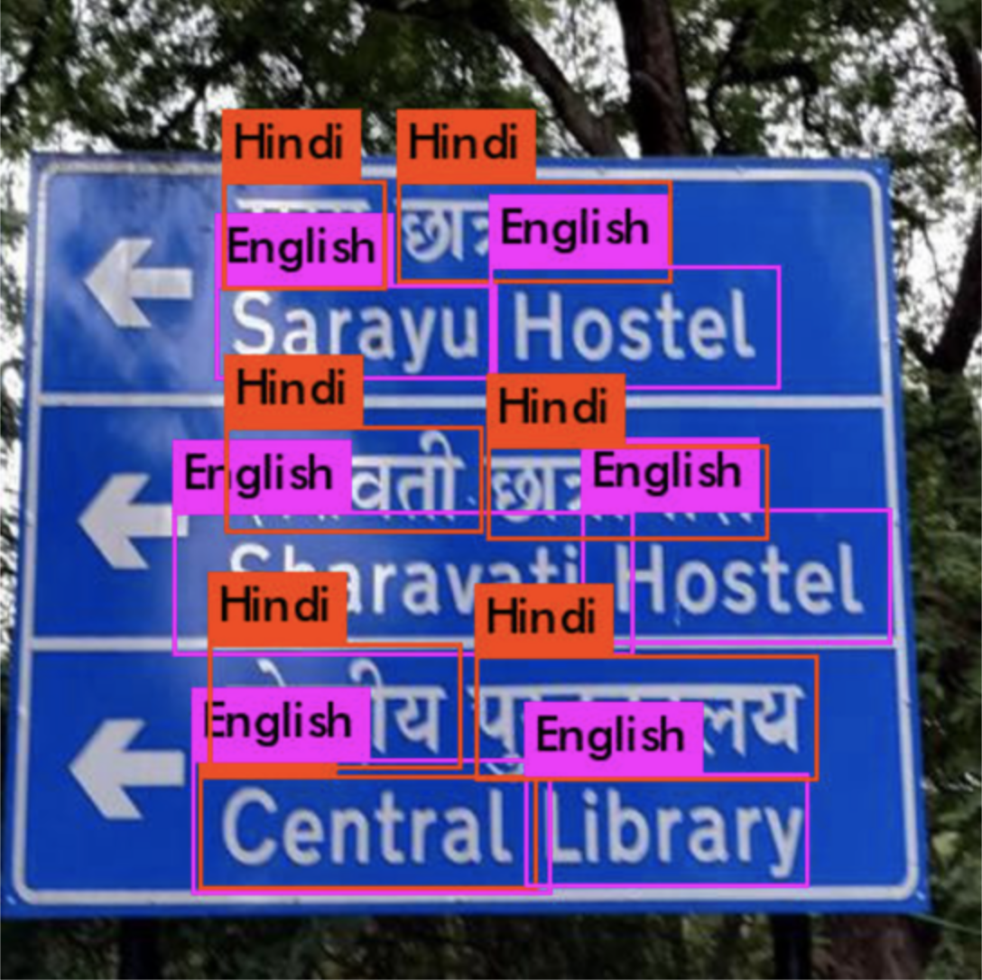
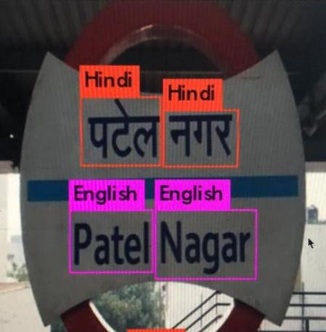
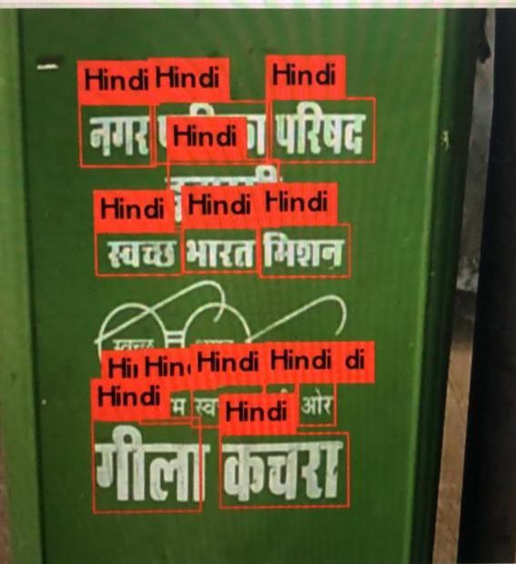
Results – Using Yolo

Slide 13
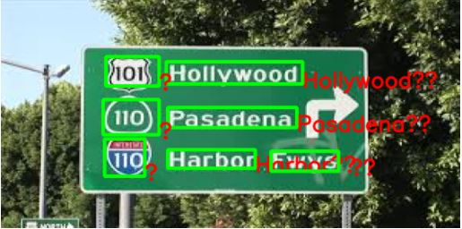
Results – Using EAST and PyTesseract

Slide 14
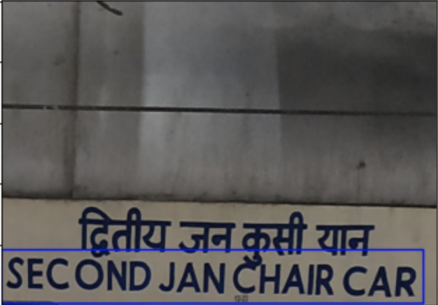
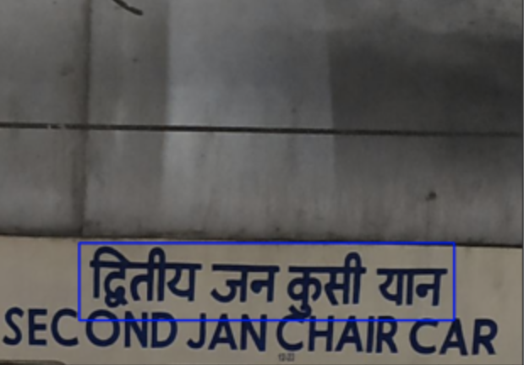
Results – Using EasyOCR

Slide 15
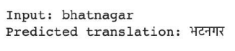
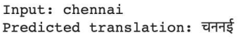
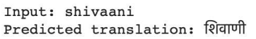
Results – Using Seq2Seq model with Attention mechanism

Slide 16
Conclusions
Using the YOLO Algorithm we are able to classify the language presented in the signboard and this reduces the complexity in transliteration by not processing dictionary for all languages.
This detection is also performed using EAST algorithm along with Detection of the characters in the image.
Further PyTesseract and Easy OCR is used for retrieval of the text from the presented image after classification of it’s language.
After this, Transliteration of this text to the desired language is to be performed.

Slide 17
Scope for improvement
This project predominantly involves Hindi and English languages. This can be further extended to multiple languages when there are proper datasets available. Whenever proper datasets are made available, the model can be trained and developed with those languages in order to serve other native speakers.
To reach all the citizens this project can be developed into a Mobile Application which is user friendly and available in all languages. This increases the usability to a broader range of people over the country.

Slide 18
Literature review
Computer vision has been tremendously transformed and reshaped. As an important research area in computer vision, scene text detection and recognition has been inevitably influenced by this wave of revolution, consequentially entering the era of deep learning. The survey in [1] aims at summarizing and analysing the major changes and significant progresses of scene text detection and recognition in the deep learning era. In this article, new insights and ideas, recent techniques, benchmarks and future trends of text detection and recognition are discussed.
In [2], an approach based on colour channel selection for text recognition from scene images and video frames is proposed. In this, a colour channel is automatically selected and then selected colour channel is considered for text recognition. From each sliding window of a colour channel, the colour-channel selection approach analyses the image properties from the sliding window and then a multi-label Support Vector Machine classifier is applied to select the colour channel that will provide the best recognition results in the sliding window. This colour channel selection for each sliding window has been found to be more fruitful than considering a single colour channel for the whole word image.

Slide 19
Literature review
The proposed model in [3] localizes text regions in a given scene image and provides text transcription as a sequence of characters for all regions with text. The model is jointly optimized for both text localization and recognition in an end-to-end training framework. This method achieves state-of-the-art accuracy in the end-to-end text recognition on standard datasets and is faster than other competing methods
In [4], a novel method for machine transliteration is proposed based on Deep Belief Networks, which despite not having competitive results can be an important additional cue for system combination setups. Common approaches use finite state machines or other methods similar to conventional machine translation. Instead of using conventional NLP techniques, the approach presented in this builds on a technique which is shown to work well for other machine learning problems. It is shown that deep belief networks have certain properties which are very suitable for transliteration and translation of text.

Slide 20
Literature review
In [5] work, we present GNMT, Google’s Neural Machine Translation system, which attempts to address many of these issues. To improve handling of rare words, we divide words into a limited set of common sub-word units (“word pieces”) for both input and output. This method provides a good balance between the flexibility of “character”-delimited models and the efficiency of “word”-delimited models, naturally handles translation of rare words, and ultimately improves the overall accuracy of the system. To improve parallelism and therefore decrease training time, our attention mechanism connects the bottom layer of the decoder to the top layer of the encoder. To accelerate the final translation speed, we employ low-precision arithmetic during inference computations.
In [6] work, we propose a simple yet powerful pipeline that yields fast and accurate text detection in natural scenes. The pipeline directly predicts words or text lines of arbitrary orientations and quadrilateral shapes in full images, eliminating unnecessary intermediate steps (e.g., candidate aggregation and word partitioning), with a single neural network. The simplicity of our pipeline allows concentrating efforts on designing loss functions and neural network architecture.

Slide 21
Time line
Feb – Phase 1 : Text Boundary Detection using Yolo and East.
1st March until Mar 15 : Phase 2 : Text Recognition from the image with boundary box using PyTesseract and EasyOCR
Currently Working (From March 15) : Working on Phase 3 – Transliteration.
April : Drafting the paper for the developed project.
May : Final Thesis preparation.

Slide 22
Reference
[1] Long, S., He, X., & Ya, C. (2018). Scene text detection and recognition: The deep learning era. arXiv preprint arXiv:1811.04256.
[2] Bhunia, A. K., Kumar, G., Roy, P. P., Balasubramanian, R., & Pal, U. (2018). Text recognition in scene image and video frame using Color Channel selection. Multimedia Tools and Applications, 77(7), 8551-8578.
[3] Busta, M., Neumann, L., & Matas, J. (2017). Deep textspotter: An end-to-end trainable scene text localization and recognition framework. In Proceedings of the IEEE International Conference on Computer Vision (pp. 2204-2212).
[4] Deselaers, T., Hasan, S., Bender, O., & Ney, H. (2009, March). A deep learning approach to machine transliteration. In Proceedings of the Fourth Workshop on Statistical Machine Translation (pp. 233-241). Association for Computational Linguistics.
[5 ]Google’s Neural Machine Translation System: Bridging the Gap between Human and Machine Translation Yonghui Wu, Mike Schuster, Zhifeng Chen, Quoc V. Le, Mohammad Norouzi
[6] EAST: An Efficient and Accurate Scene Text Detector. Xinyu Zhou, Cong Yao, He Wen, Yuzhi Wang, Shuchang Zhou, Weiran He, and Jiajun Liang Megvii Technology Inc., Beijing, China

Slide 23
Reference
[7] Neumann, L. and J. Matas, A method for text localization and recognition in real-world images. In Proceedings of the 10th Asian Conference on Computer Vision - Volume Part III, ACCV’10. Springer-Verlag, Berlin, Heidelberg, 2011. ISBN 978-3-642-19317-0.
[8] Rosca, M., & Breuel, T. (2016). Sequence-to-sequence neural network models for transliteration. arXiv preprint arXiv:1610.09565.
[9] Bartz, C., Yang, H., & Meinel, C. (2018, April). SEE: towards semi-supervised end-to-end scene text recognition. In Thirty-Second AAAI Conference on Artificial Intelligence.
[10] Tian, Z., Huang, W., He, T., He, P., & Qiao, Y. (2016, October). Detecting text in natural image with connectionist text proposal network. In European conference on computer vision (pp. 56-72). Springer, Cham.

